Slide 1
MALIGNANT COMMENT CLASSIFICATION PROJECT
BY SANJAY SIVAKUMAR

Slide 2
BACKGROUND OF THIS PROJECT
The proliferation of social media enables people to express their opinions widely online. However, at the same time, this has resulted in the emergence of conflict and hate, making online environments uninviting for users.
Online hate, described as abusive language, aggression, cyberbullying, hatefulness and many others has been identified as a major threat on online social media platforms. Social media platforms are the most prominent grounds for such toxic behaviour.
Many celebrities and influences are facing backlashes from people and have to come across hateful and offensive comments.
This can take a toll on anyone and affect them mentally leading to depression, mental illness, self-hatred and suicidal thoughts.

Slide 3
PROBLEM FRAMING
Internet comments are bastions of hatred and vitriol. While online anonymity has provided a new outlet for aggression and hate speech, machine learning can be used to fight it.
The problem we sought to solve was the tagging of internet comments that are aggressive towards other users. This means that insults to third parties such as celebrities will be tagged as unoffensive, but “u are an idiot” is clearly offensive.
Our goal is to build a prototype of online hate and abuse comment classifier which can used to classify hate and offensive comments so that it can be controlled and restricted from spreading hatred and cyberbullying.

Slide 4
HARDWARE AND SOFTWARE REQUIREMENTS
Programming language – python 3.0
Libraries and Packages
1.pandas- for data framing the dataset
2.numpy- for any analytical functions
3.seaborn and matplotlib-for visualization process
4.And for the NLP process we use TfidVectorizer to convert our review data from string to vector.
5.train_test_split- for splitting data into training and testing
6.And I have imported classification algorithms such as naïve bayes algorithms, RandomForest classifier etc… for model building.
6.And finally imported metrics for classification problem for proper model selection.

Slide 5
TECHNIQUES AND METHODS USED
1.Cleaning the review column as their will be many unwanted words such as special characters, stop words etc...
2.Finally converting all the current words to lower case after transforming to stemming for the purpose of model building.
3.Using TfidVectorizer which is the NLP process to convert the string data in review column to vector format for model building purpose.

Slide 6
ALGORITHMS USED FOR MODEL BUILDING
1.Naive Bayes Algorithms
2.Random Forest Classifier
3.Decision Tree Classifier
4.Logistic Regression

Slide 7
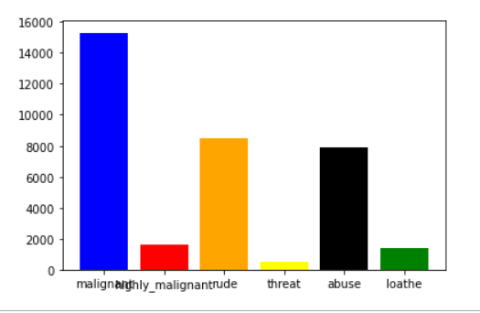

Slide 8
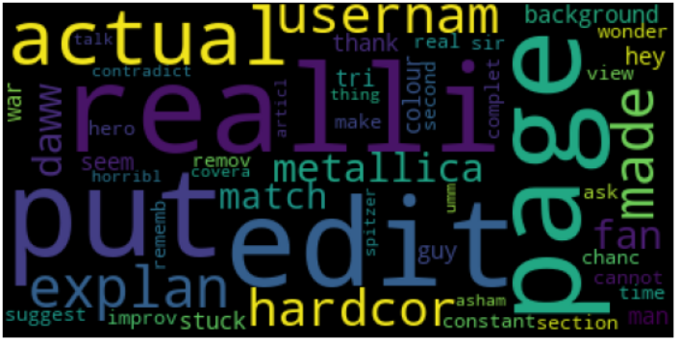

Slide 9
KEY METRICS USED
1.Accuracy score- to know the accuracy of the model
2.Confusion matrix- provides us the number of correct and incorrect predictions
3.Classification report-provides us the precision and recall value of the model

Slide 10
FINAL MODEL-LOGISTIC REGRESSION
THE METRICS AND AUC-ROC SCORE IS BETTER IN THIS ALGORITHM COMPARATIVELY.

Slide 11
CONCLUSION
After my final model I got an accuracy which is pretty good in this scenario and this accuracy can be further increased by adding more by using advanced feature Engineering to this dataset.

